Slide 1
UBER DATA ANALYSIS PREDICTION

Slide 2
Abstract | 2
Introduction | 3
Problem statement | 4
Objective | 5
Plan of action | 6-9
Visualizations and predictions | 10-12
Conclusion | 13
Meeting Links | 15
References | 16

Slide 3
Abstract
Data analytics has helped companies optimize and grow their performance for decades.
Data analytics and visualization has aided us with several benefits, few of them being identifying emerging trends, studying relationships and patterns in data, analysis in depth and cherry on top are the insights we draw from these patterns.
The project explains the working of an Uber dataset, which contains data produced by Uber for New York City.
The dataset includes primary data on Uber pickups with details including the date, time of the ride as well as longitude-latitude information

Slide 4

Introduction
Uber is one of the fastest-growing company in the world which has risen within a short time. Uber has more than 5 million drivers as per analysis. An international company located in 69 countries and around 900 cities around the world.
Uber has been a major source of travel for people living in urban areas. Some people don’t have their vehicles while some don’t drive their vehicles intentionally because of their busy schedule. So different kinds of people are using the services of Uber.
In our project we will analyze the uber pickups in New York city.

Slide 5
Problem Statement
Not only pros but there are also cons with uber. Waiting time is one of the cons that is uber booking rides for pickup have a high waiting time of arrival of the cab and end up not booking/ cancelling the ride.
The user is finding the fare of the ride more (expensive) and end up not booking or cancelling the ride. These are few problems that are taking place and leads to cancellation of rides.
Uber faces include legal action because drivers are not licensed, rider and driver safety, protection and security of customer and driver information, and a lack of adequate insurance coverage.
The aim of our project is to study and analyse Uber Data Analysis prediction based on Uberdata dataset by taking three years data i.e, 2018, 2019 and 2020 and months from January to December.

Slide 6
Objective
The overall objective of our project will predict trips cancelled and trips completed by passengers and finding average number of passengers that avail uber trips in a day and Average number of trips that avail uber trips in days of week and plotting graphs between Years, months, days, days of week and hours for better understanding.
Each row in the data set provides relevant information about the uber.
The Uber data analysis prediction designed to help in identifying the customers who avail the trips .
The data contains 66300 observations and 9 attributes.
Many more input attributes can be taken but our goal is to predict with few attributes and faster efficiency .

Slide 7
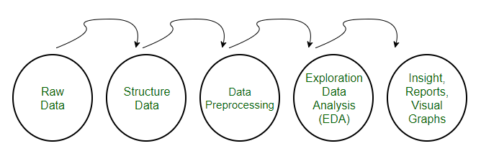
Plan Of Action
Understanding the dataset
Pre-processing dataset
Plotting graphs for better understanding of relation between attributes.

Slide 8
Understanding Dataset:
Dataset Attributes:
Date/Time: The date and time of uber pickup
Lat: The latitude of the uber pickup
Lon: The longitude of the uber pickup
Base: The base code for uber pickup
Status: The status is for whether uber ride completed or cancelled
Time: The time of uber pickup
Day: The day of uber pickup
Month: The respective month that upper pickup took place
Year: The respective year that upper pickup took place

Slide 9
Pre-processing dataset
1) Understanding dataset
Dataset Description
Dataset Attributes
Loading or Reading the Dataset
2)Pre-processing dataset
Checking missing values
Filling the missing values with mean or medium
Create factors
Checking for outliers
Removing unnecessary columns
3) Plotting graphs for better understanding of relation between attributes
Plotting Heat Map for better understanding of relation between attributes

Slide 10
Pre-processing dataset in detail:
Pre-processing refers to involves transforming raw data into an understandable format.
Removing unnecessary columns:
In our dataset second is not necessary doesn’t help us neither in prediction nor improve accuracy so we will drop those columns.
Removing outliers:
Outliers are one of those statistical issues that everyone knows about, but most people aren’t sure how to deal with
Analysing The Data through graphs:
For better understanding of relation between attributes. Helps in visualization or relationship between variables.

Slide 11
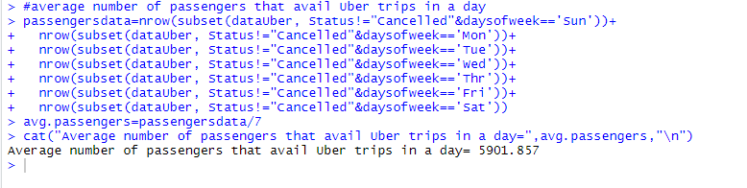
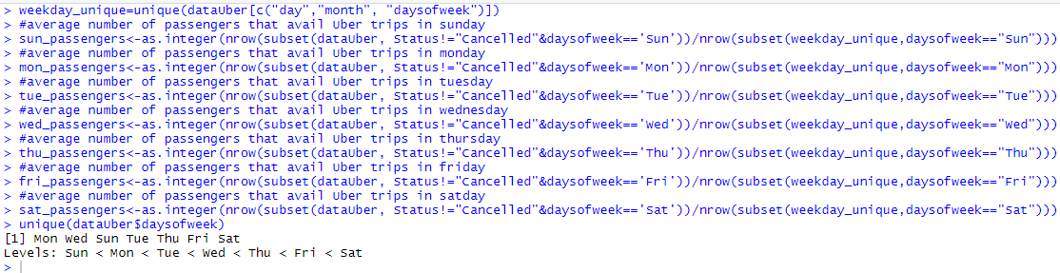
Visualizations and Predictions
Average number of passengers that avail uber trips in a day:
Average number of passengers that avail uber trips in days of Sunday, Monday, Tuesday, Wednesday, Thursday, Friday and Saturday:

Slide 12
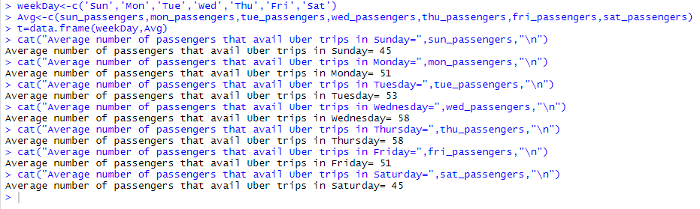
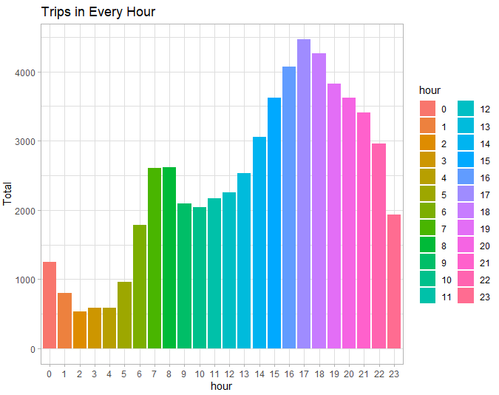
Average number of passengers that avail uber trips in a week are:
The peak hours when there is maximum traffic:

Slide 13
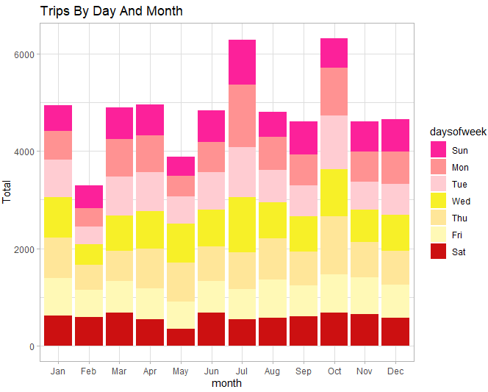
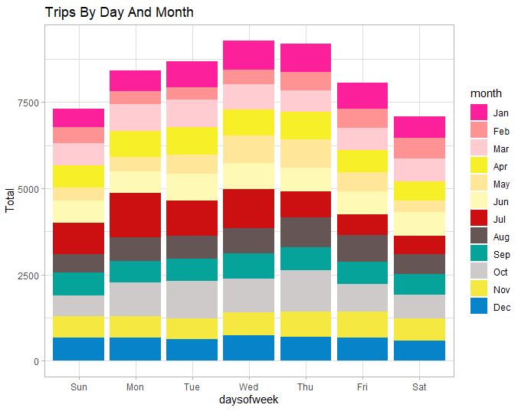
Day with highest number of trips in a month:

Slide 14
Conclusion
At the end of the Uber data analysis R project, we observed how to create data visualizations.
We made use of packages like ggplot2 that allowed us to plot various types of visualizations that pertained to several time-frames of the year.
With this, we could conclude how time affected customer trips.
Finally, we made a geo plot of New York that provided us with the details of how various users made trips from different bases.

Slide 15
REFERENCES
https://data-flair.training/blogs/r-data-science-project-uber-data-analysis/
https://www.kaggle.com/prakharrathi25/uber-data-analysis-in-r

Slide 16
Thank You

